Slide 1
Catch
“The Russian Spies” Challenge
I'm Petrov. And I'm Boshirov...

Slide 2
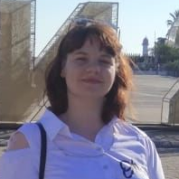



Kikot Alena
Boltinskaya Elizaveta
Zakirova Ksenia
Vampilova Erzhena
Catchers team

Slide 3
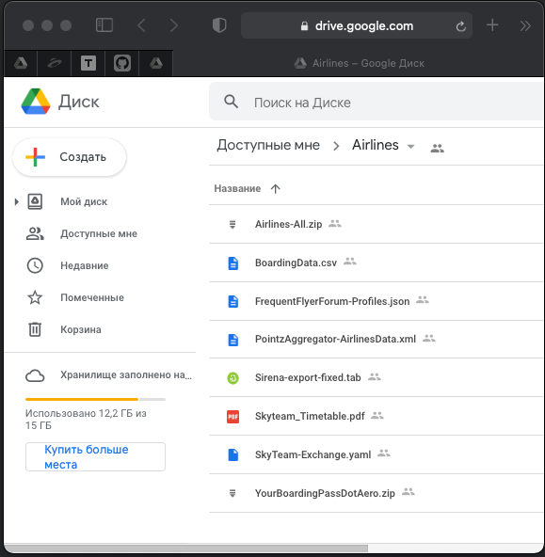
Challenge info
Challenge goal:
To develop algorithmic software for the analysis of given data in order to identify spies
Initial data:
7 different type of data

Slide 4
Roadmap
Data preparation
Hypotheses testing
1
3
2
Hypotheses

Slide 5
Data preparation
1

Slide 6
Merge all data into one
Methods:
Python scripts
Using Adobe Reader
Complications:
Data in .tab in Russian lang.
Data duplication
Different format of information
Result:
One dataset with all information
.csv
.json
.xml
.tab
.pdf
.yaml
.xlsx
.csv

Slide 7
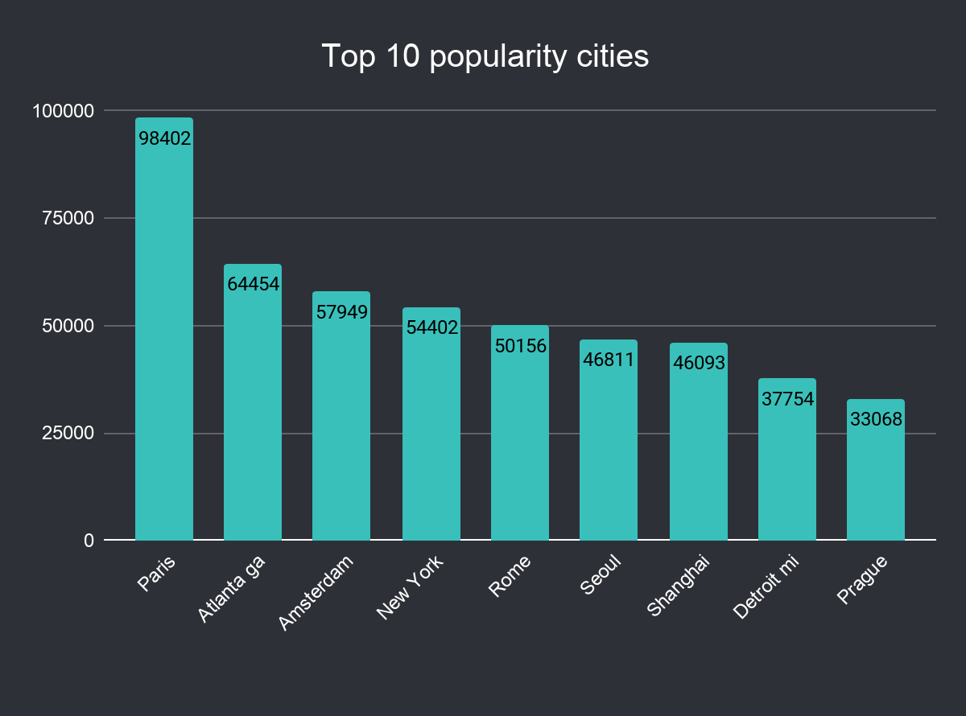
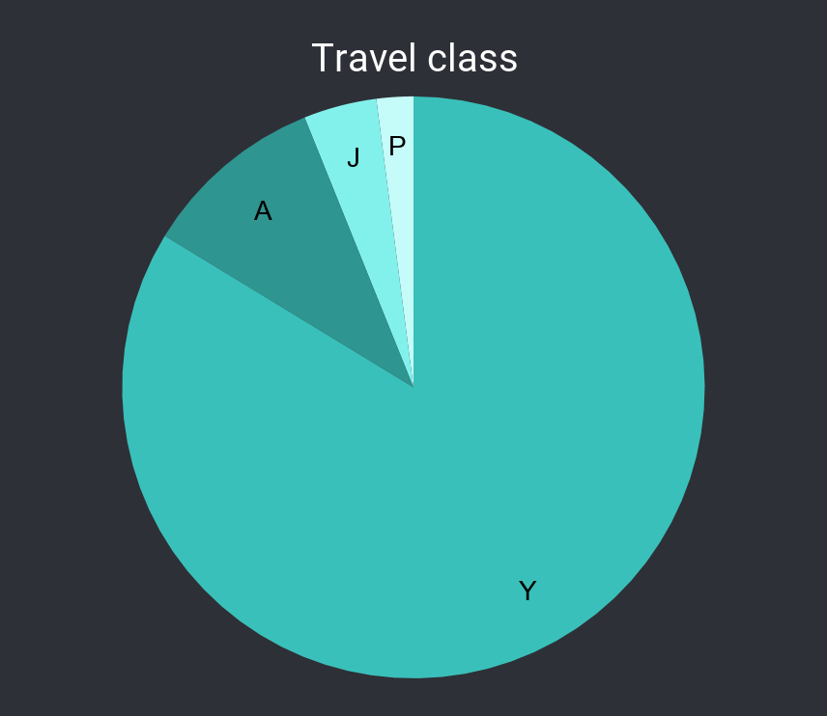
Some statistic info
Popular Moscow airports
airport | flights count
SVO | 351175
VKO | 7546
DME | 71
Popular months for flight
month | flights count
January | 334217
Mart | 295659
December | 273916
August | 271580
June | 262207
Y - Economy
J - Full Fare Business Class
A - First Class Discounted
P - First Class
Except Moscow (358792) and Saint Petersburg (46617)

Slide 8
Hypotheses
2

Slide 9
Suspicious couples
Passengers (not family) who fly together frequently
Baggage
Passengers who left and returned with different amounts of luggage and the time between flights did not exceed 5 days.
Smart spy
Passengers with multiple tickets at the same time (the goal is to confuse)
Business lunch
The spy has no time for lunch, so he buys meals on board
"Two-faced Janus"
Passengers with multiple passports
No card-loyalty
Passengers without a loyalty card who fly frequently

Slide 10
Ivanov Ivan
Passengers with common first and last names
Confidentially
Passengers with a minimum amount of information (no date of birth / last name)
Time Machine
Passengers with age anomalies

Slide 11
Hypothesis testing
3

Slide 12
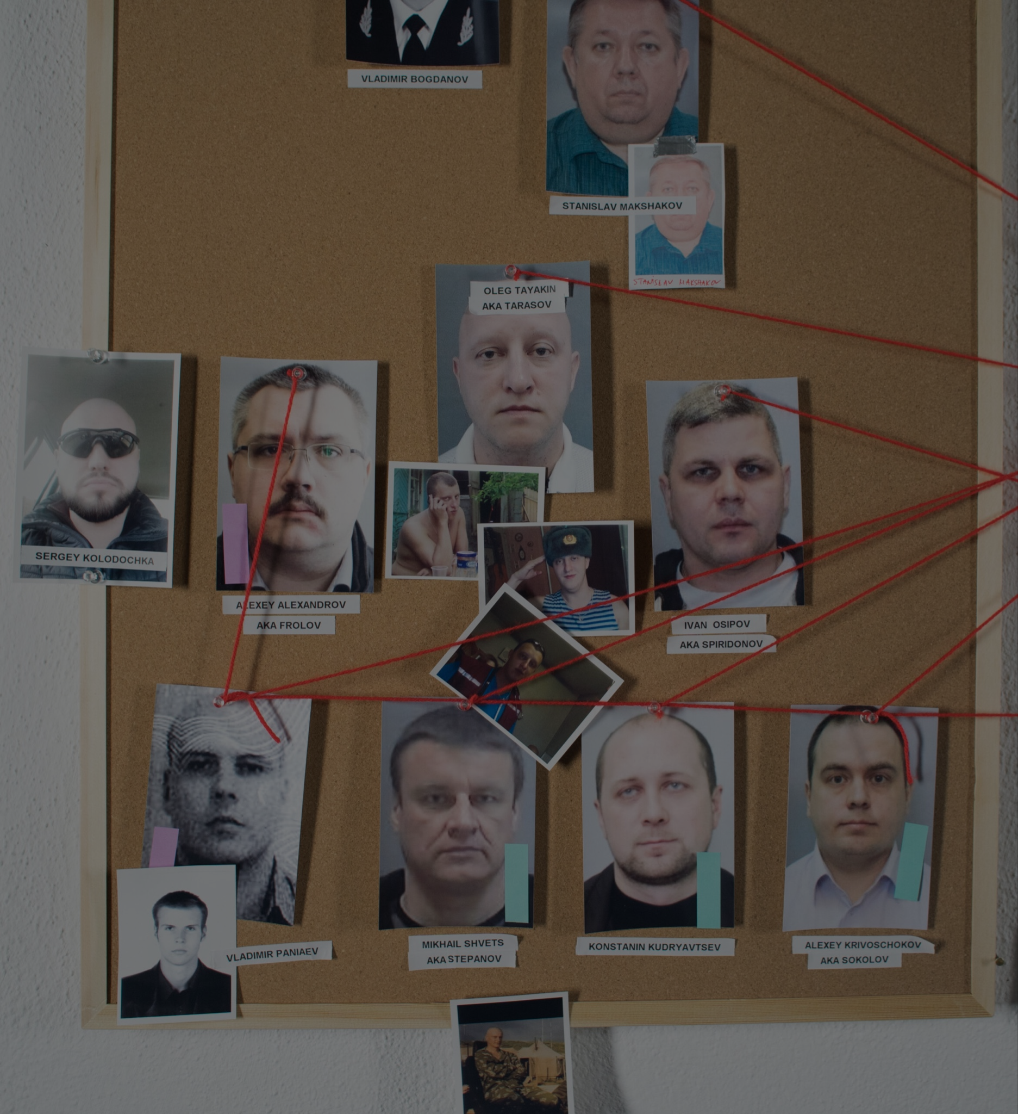
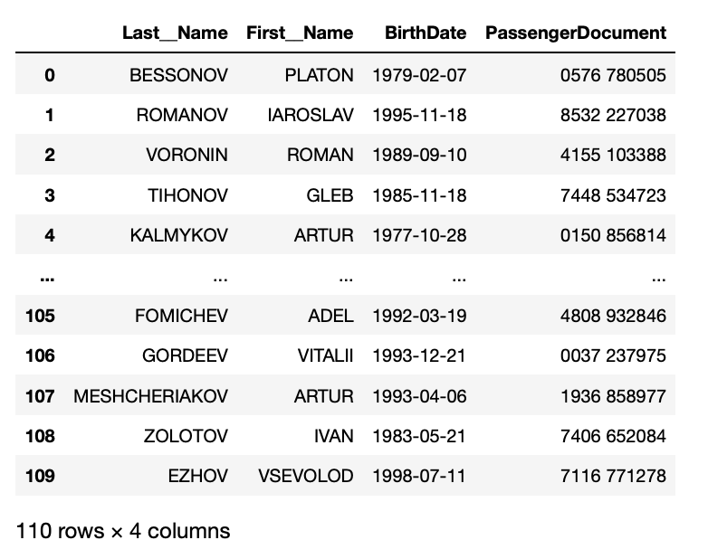
Suspicious couples
Algorithm:
Filter data by gender (Male)
Check the number of passenger flights (>2)
Find passengers who fly together
Realization:
Python
Results:
98 couples
List of suspicious passengers

Slide 13
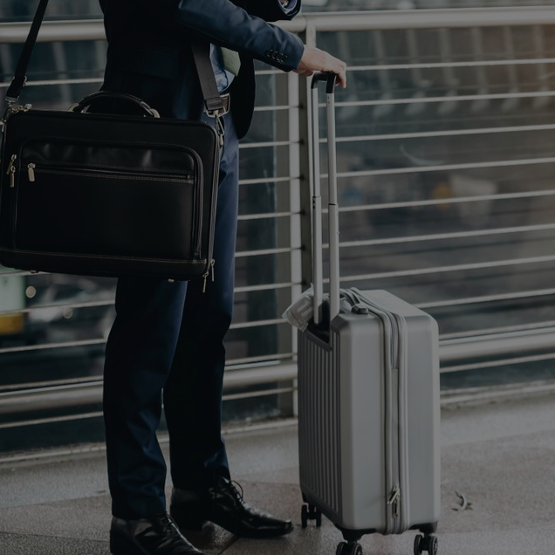
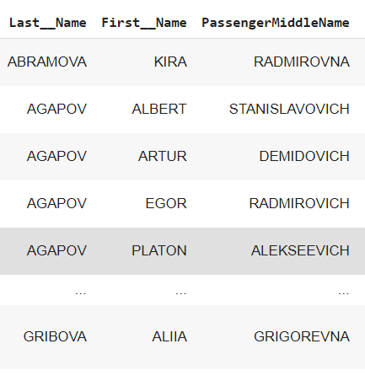
Baggage
Algorithm:
Filtering passengers who have different baggage information
Filtering passengers who have a difference between trips of less than 5 days
Realization:
Python
Results:
107 couples
List of suspicious passengers

Slide 14
Smart spy
Algorithm:
Sort data by people
Check for a person whether he has several tickets for one day, while the city of arrival and the city of departure do not match
Realization:
Python
Results:
0 couples
So we can conclude that the spy uses other methods to confuse his tracks and does not fall for such markers.

Slide 15
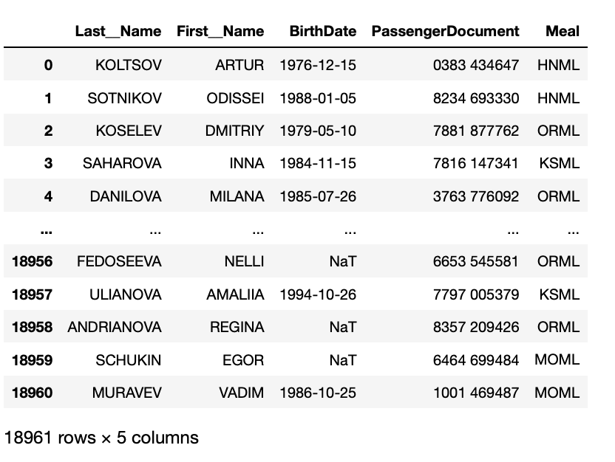
Business lunch
Code | Meal
LSML | Low Salt
FPML | Fruit
VGML | Vegan
NLML | Low Lactose Food.
DBML | Diabetic
VLML | Vegetarian with Milk and Eggs
ORML | Simply oriental cuisine (not diet / religious)
HNML | Hindu Non-Vegetarian (Hindu)
MOML | Muslim
KSML | Kosher
RVML | Raw Vegetables and Fruits
Algorithm
Take usual meal and meal based on religious
Realization
Python
Results
Pay attention to 18961 passengers
List of suspicious passengers

Slide 16
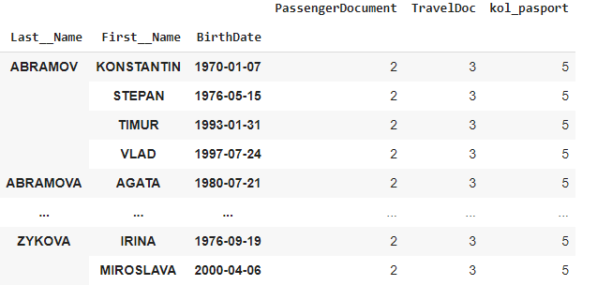
"Two-faced Janus"
Algorithm:
Sorted the data by people
Checking for matching passport numbers
Counting the number of people with more than 4 passports
Realization:
Python
Results:
5275 couples
List of suspicious passengers

Slide 17
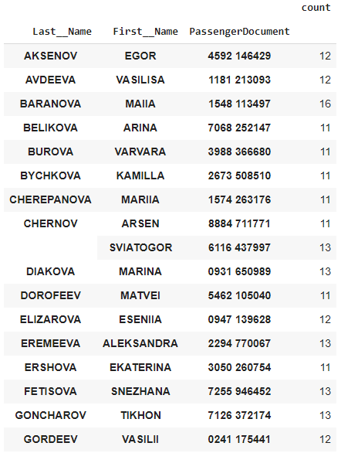
No card-loyalty
Algorithm:
Filter out people who don't have a loyalty card
Check the number of passenger flights (>10)
Realization:
Python
Results:
56 couples
Flights count | Passengers count
11 | 32
12 | 12
13 | 10
14 | 1
16 | 1
List of suspicious passengers

Slide 18
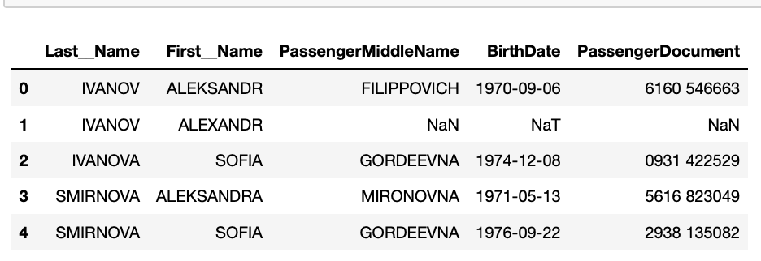
Ivanov Ivan
Algorithm:
Set the list of common first and last name
Find passengers who has match with list
Source:
adme.ru (life-style journal)
Realization:
Python
Results:
4 passengers
List of suspicious passengers

Slide 19
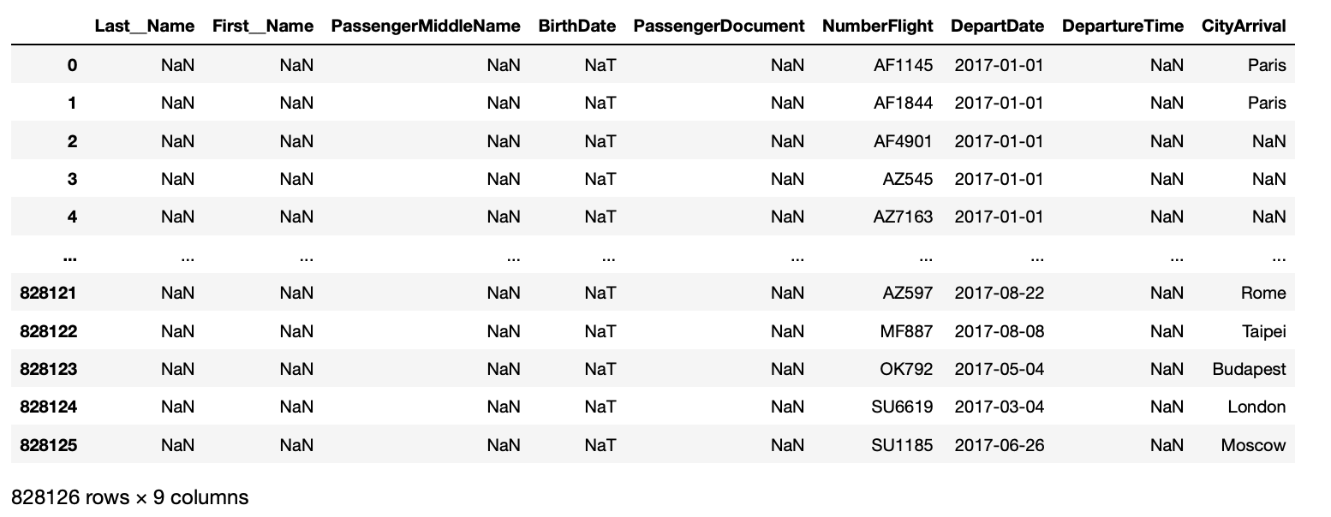
Confidentially
Algorithm:
Find passengers with nan last name, birth date, documents number, ticket number
Realization:
Python
Results:
828k passengers
Notes: it can system mistakes or merging extra data

Slide 20
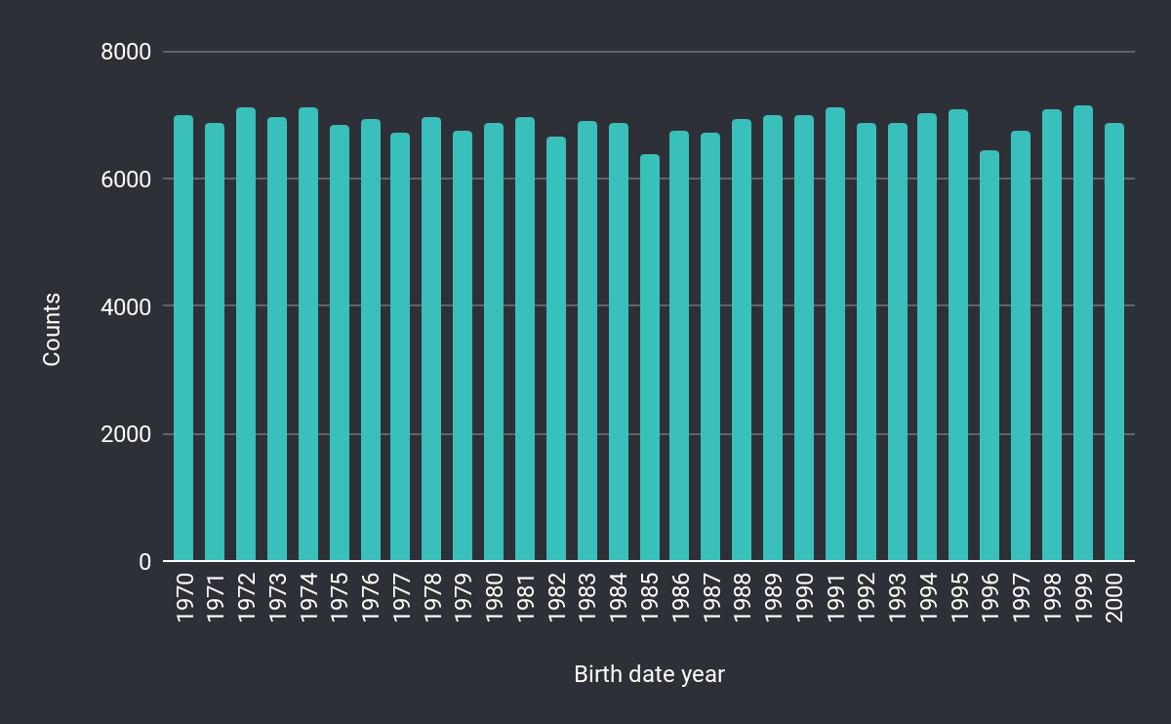
Time Machine
Algorithm:
Find passengers with age anomaly
Realization:
Python
Results:
0 passengers
The youngest: 2000-12-30
The oldest: 1970-01-02

Slide 21

git repository
https://github.com/kseneyaa/airlines.git

Slide 22
Thanks!
ANY QUESTIONS?

